Slide 1
Refugee Resettlement Assistance Model (RRAM)
CS349 Final Project
Noah Depp, Oscar Depp
Department of Computer Science

Slide 2
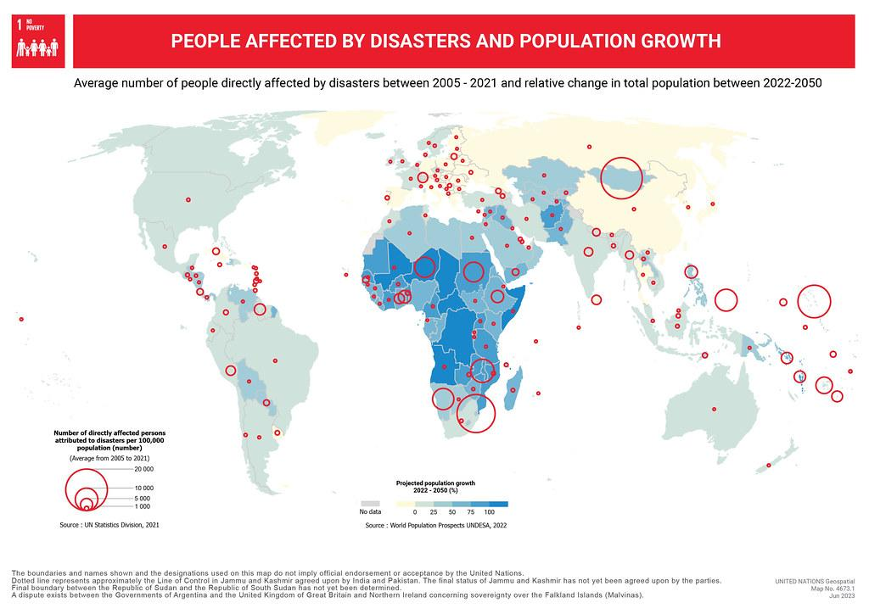
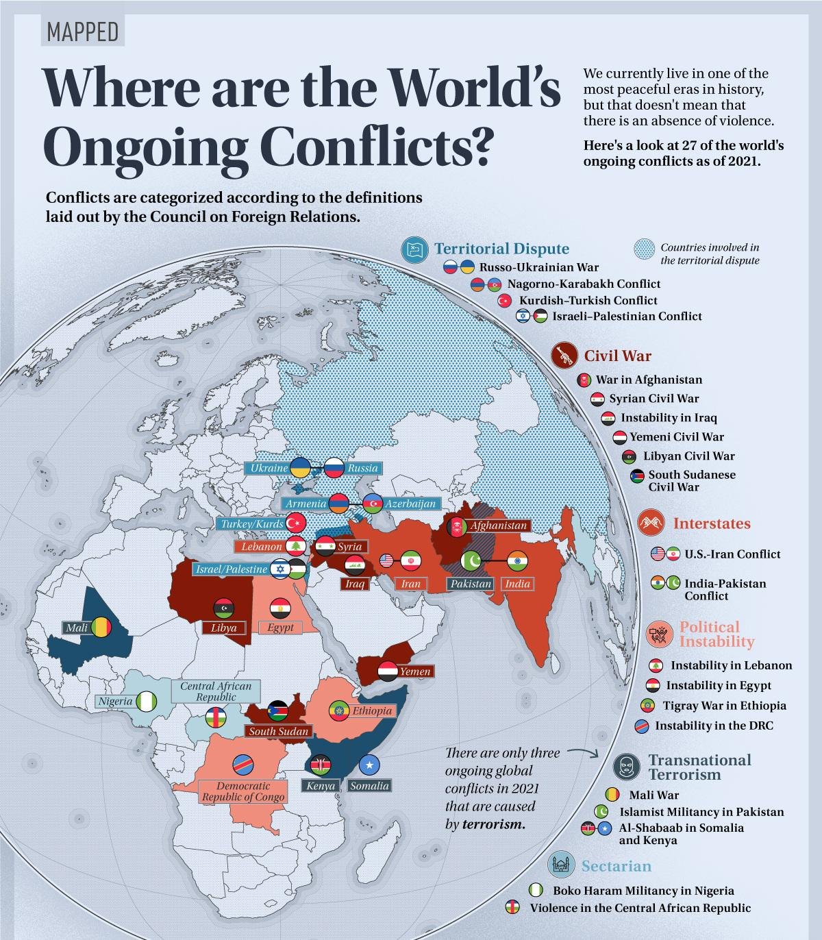
Introduction & Motivation
Fig 1a. Historical data of people affected by natural disasters and forecasted pop. growth between 2022-2050[1].
Fig 1b. 2023 Human conflicts around the world visualized[2].
114 million people displaced through war, persecution, and natural disasters (UNHCR [3]).

Slide 3
GOAL

Slide 4
Goal
Provide a framework to predict the demand of people who are displaced from disasters and assist them in determining a “good” location to resettle
Predict the scale of how many people will be displaced when a natural disaster happens in a given country
Rate and recommend groups of locations in a country based off of universal indicators set by UNHCR, WHO, and UNICEF

Slide 5
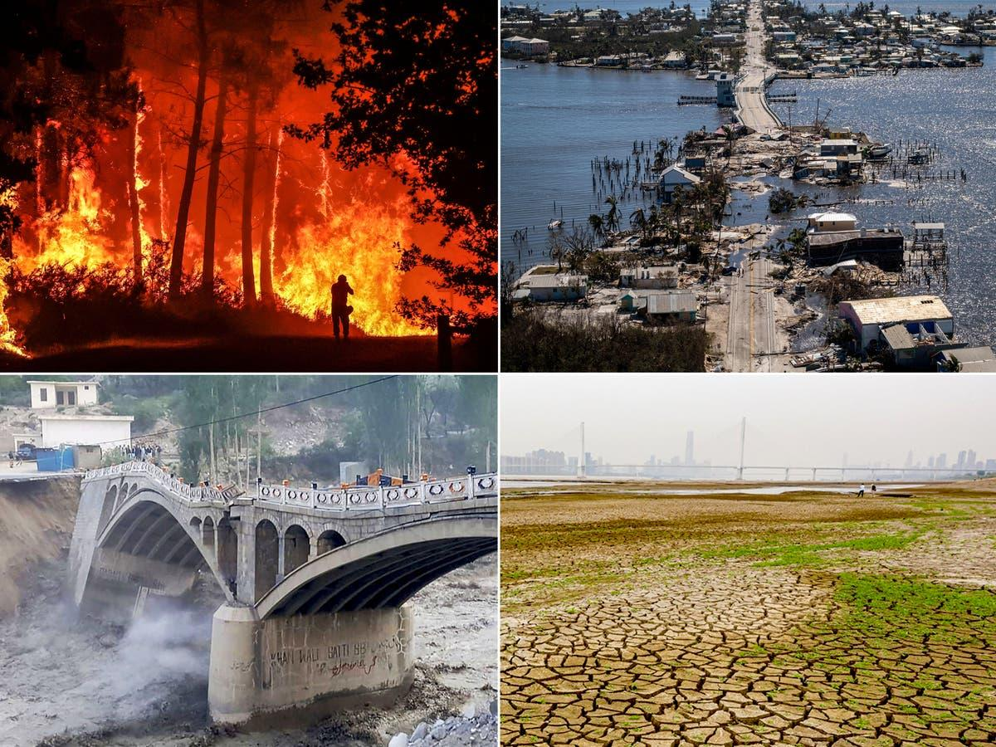
Climate Disasters
Notes:
Climate refugees belong to a larger group of immigrants known as environmental refugees. Environmental refugees include immigrants forced to flee because of natural disasters, such as volcanoes and tsunamis.
The International Red Cross estimates that there are more environmental refugees than political refugees fleeing from wars and other conflicts. The United Nations High Commissioner for Refugees (UNHCR) says 36 million people were displaced by natural disasters in 2009, the last year such a report was taken. A 2021 World Bank reported estimated that the climate crisis could drive more than 200 million people to move within their countries by 2050. In 2020 the Institute for Economics and Peace put the number of people at risk of displacement by 2050 at over 1 billion.
Flooding
Maldives
Maldives, an island nation in the Indian Ocean, is perhaps the country most threatened by sea level rise. Maldives rises only 2.4 meters (eight feet) above sea level at its highest point. Sea-level rise will likely create climate refugees because of changes in both economy and habitat.
Tourism supports more than 25 percent of the Maldivian economy. As the islands slowly sink underwater, they can support fewer tourists and tourist facilities, such as hotels. Fishing is the nation’s second-largest industry.
Drought
While rising seas threaten coastal regions, drought can create climate refugees inland. When people cannot grow crops on the land where they live, they have to move somewhere else in order to survive. For example, the Gobi Desert in China expands more than 3,600 square kilometers (1,390 square miles) every year. Farmers and merchants in the area surrounding the Gobi migrate to China’s crowded urban areas as grasslands are overtaken by desert.

Slide 6
Example of Relevant Development Indicators
'Investment in energy with private participation (current US$)',
'Labor force participation rate, total (% of total population ages 15+) (modeled ILO estimate)',
'GDP per person employed (constant 2017 PPP $)',
'Agriculture, forestry, and fishing, value added (% of GDP)',
'Net official development assistance received (current US$)',
'Refugee population by country or territory of asylum',
'Land under cereal production (hectares)', 'Population, total',
'Access to electricity, urban (% of urban population)',
'GDP (current US$)', 'Cereal yield (kg per hectare)',
'Annualized average growth rate in per capita real survey mean consumption or income, bottom 40% of population (%)',
'Personal remittances, received (current US$)',
'Poverty headcount ratio at $2.15 a day (2017 PPP) (% of population)',

Slide 7


World Bank Database:
Notes:
On that note, the number of displaced persons depends on not only the type of disaster and the magnitude, but on a wide array of factors such as the themes in the world development indicators listed here. We decided that factors such as inequality, % of population in poverty, and % of GDP in agriculture would provide some indication of the level of displacement of people due to climate.
EM-DAT: The International Disaster Database: This database by the Centre for Research on the Epidemiology of Disasters (CRED) provides information on disasters globally, including estimated economic losses. While not directly on government spending, it can help identify events and their potential fiscal impact.

Slide 8
Types of Disasters Tracked
Climatological
Drought
Glacial lake outburst flood
Wildfire (forest fire, land fire, wildfire)
Geophysical
-Earthquake(ground movement, tsunami)
-Mass movement (avalanche, landslide rockfall, sudden subsidence)
-Volcanic activity (ash fall lahar, lava flow pyroclastic flow, volcanic activity general)
Hydrological
flood (coastal flood, flash flood, flood (general),
ice jam flood, riverine flood)
Mass movement (wet) (avalanche, landslide, mudslide, rockfall, sudden subsidence)
wave action (rogue wave, seiche)
Meteorological
extreme temperature (cold wave, heat wave, severe winter conditions)
Fog
Storm(blizzard/winter storm, derecho, extra-tropical storm, hail, lightning/thunderstorms, sand/dust storm, severe weather, storm, storm surge, tornado, tropical cyclone)

Slide 9
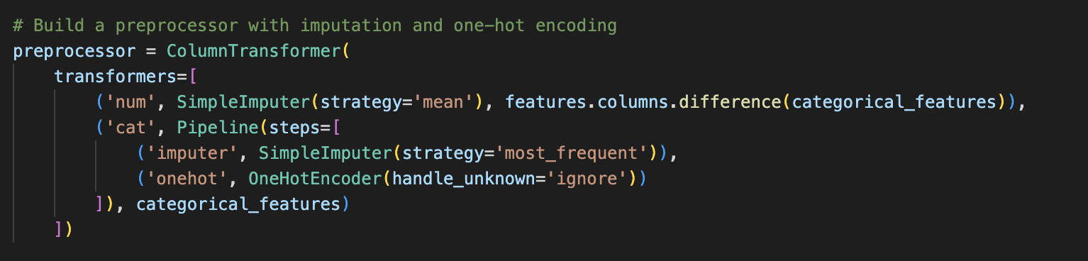
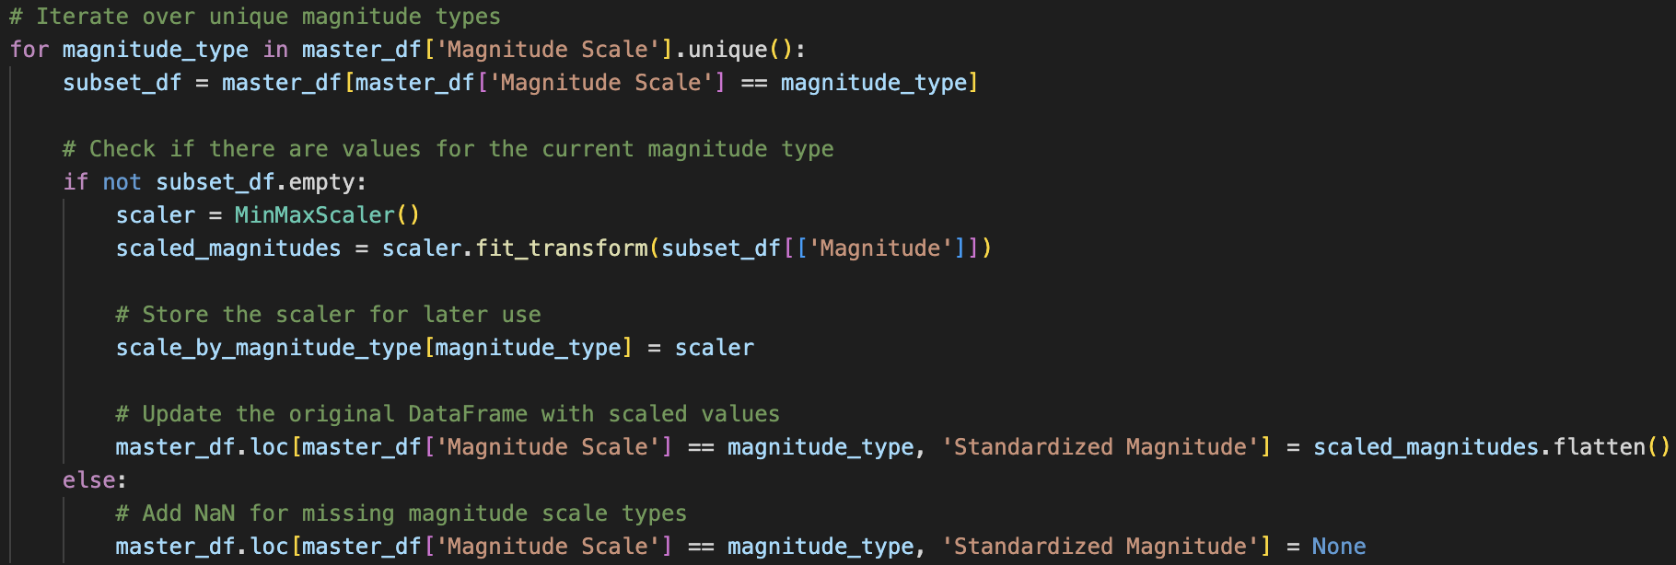
Data Processing
Notes:
min max

Slide 10
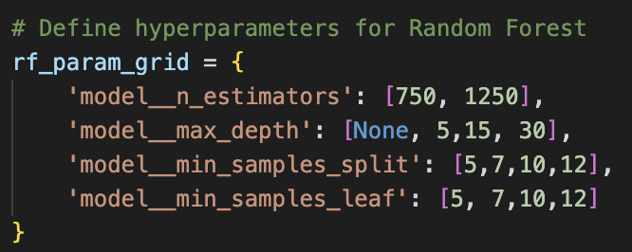
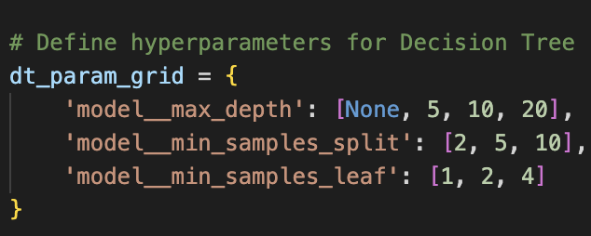
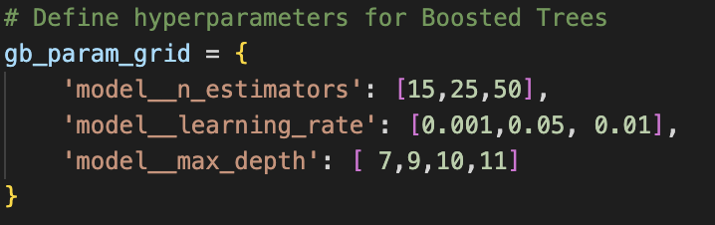
Grid Search, 10 fold Cross Validation
Notes:
split 85/15 for test/training

Slide 11

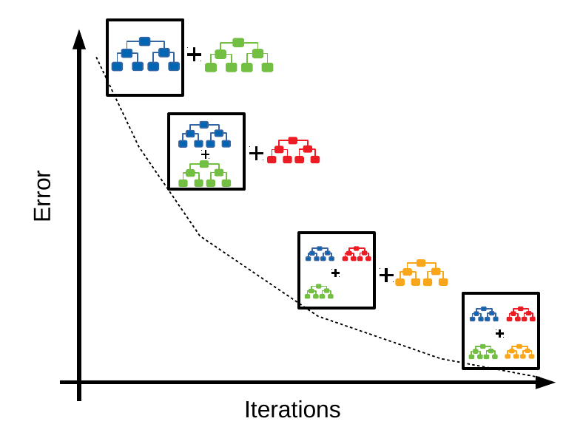
Model
Boosted Tree Graphics
Notes:
RF:
Random Forest Algorithm
For l = 1,2, ... , m: 8s Is
a) Draw a bootstrap sample n" , o" of size 5 rows
b) Grow an individual tree Tb to the bootstrapped sample by iteratively repeating the following steps for each terminal node of the tree at the current iteration, until the minimum node size (an important tuning parameter specified by the user) is reached:
i. Select 2 (another tuning parameter) predictor variables randomly from among the full set of 3 predictors
ii. From among these 2 predictors, choose the best predictor and split point the same way you do for regular trees
iii. Spit the node into two child nodes according to
Output the ensemble of trees p": l = 1,2, ... . m
2) To predict the response y at any new x:
For regression: yhat =1/B ∑b=1BTb(X) (ave. predicted Y from all B trees)
Boosted: (Gradient) boosting sequentially fits weak models (almost always simple trees) to the residuals from the previous iteration, taking the final model to be the sum of the individual models from each iteration
• Notation:
M = # of trees/iterations to fit f(x) = predictor of y(x)
L(yi,f(xi)) = loss function to be minimized when fitting rim = psuedo-residual of {yi, xi} at iteration m
Jm = # nodes for mth tree

Slide 12
Results
Decision Tree Best Parameters: {'model__max_depth': 5, 'model__min_samples_leaf': 1, 'model__min_samples_split': 2}
Decision Tree Test RMSE: 517515.6525927585
Decision Tree Test r^2: -0.1011460571894276
Random Forest Best Parameters: {'model__max_depth': 5, 'model__min_samples_leaf': 12, 'model__min_samples_split': 5, 'model__n_estimators': 750}
Random Forest Test RMSE: 510990.7908517855
Random Forest Test r^2: -0.07355449572470518
Boosted Trees Best Parameters: {'model__learning_rate': 0.001, 'model__max_depth': 7, 'model__n_estimators': 50}
Boosted Trees Test RMSE: 493647.78469854733
Boosted Trees Test r^2: -0.0019183557287054676
Notes:
Comparison between models and decision trees A negative R-squared ($r^2$) value for test results indicates that the model's predictions are performing worse than a simple horizontal line (the mean of the target variable). In other words, the model is not explaining the variance in the data, and its predictions are not capturing the patterns present in the actual outcomes.
Among the three models, Boosted Trees have the lowest RMSE, suggesting better predictive performance in terms of minimizing prediction errors. However, all models exhibit negative R-squared values, indicating that they are not explaining the variance in the target variable well. This could be due to various reasons, such as inappropriate model complexity, insufficient data, or the presence of non-linear relationships that the models fail to capture.
We further investigated the data, model parameters but to no avail. Although the tree method seemed perfect for our purposes given our data and nature of the classes, we should consider feature engineering or alternative modeling approaches such as neural networks to improve predictive performance. Negative R-squared values could also suggest that the mean of the target variable might be a better predictor than the models, highlighting potential challenges in the modeling process.

Slide 13
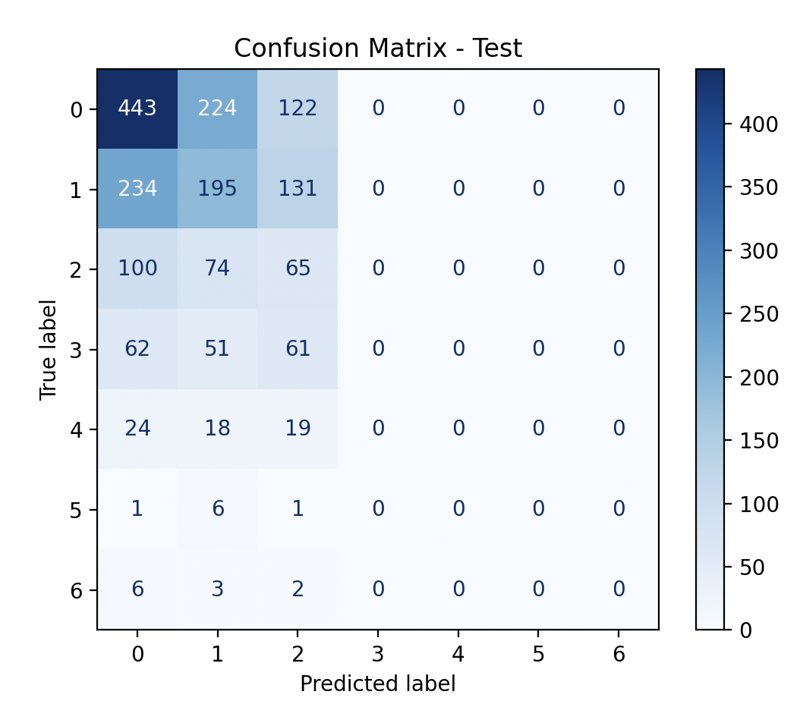
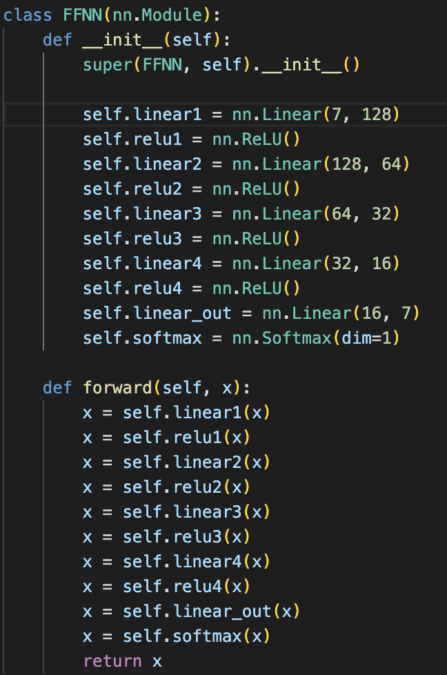
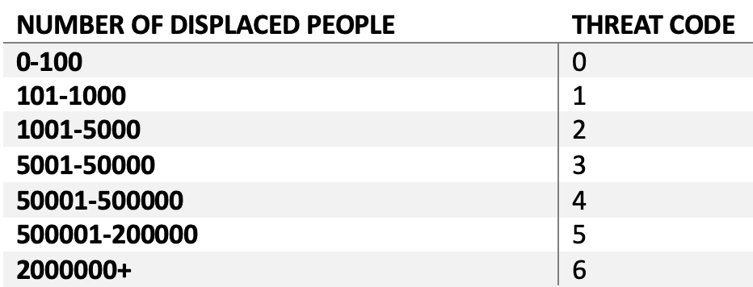
Neural Network Approach
Separating # of displaced people into buckets
after adjusting weights, accuracy was 43.75%

Slide 14
DATA

Slide 15
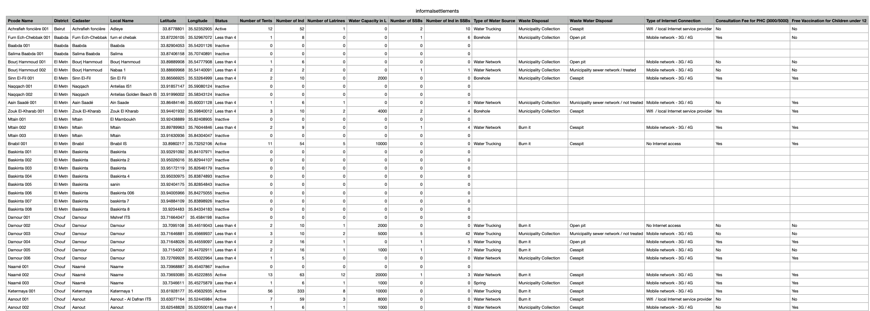
Overview of Data
Scraped from UNHCR API, Humdata.org

Slide 16
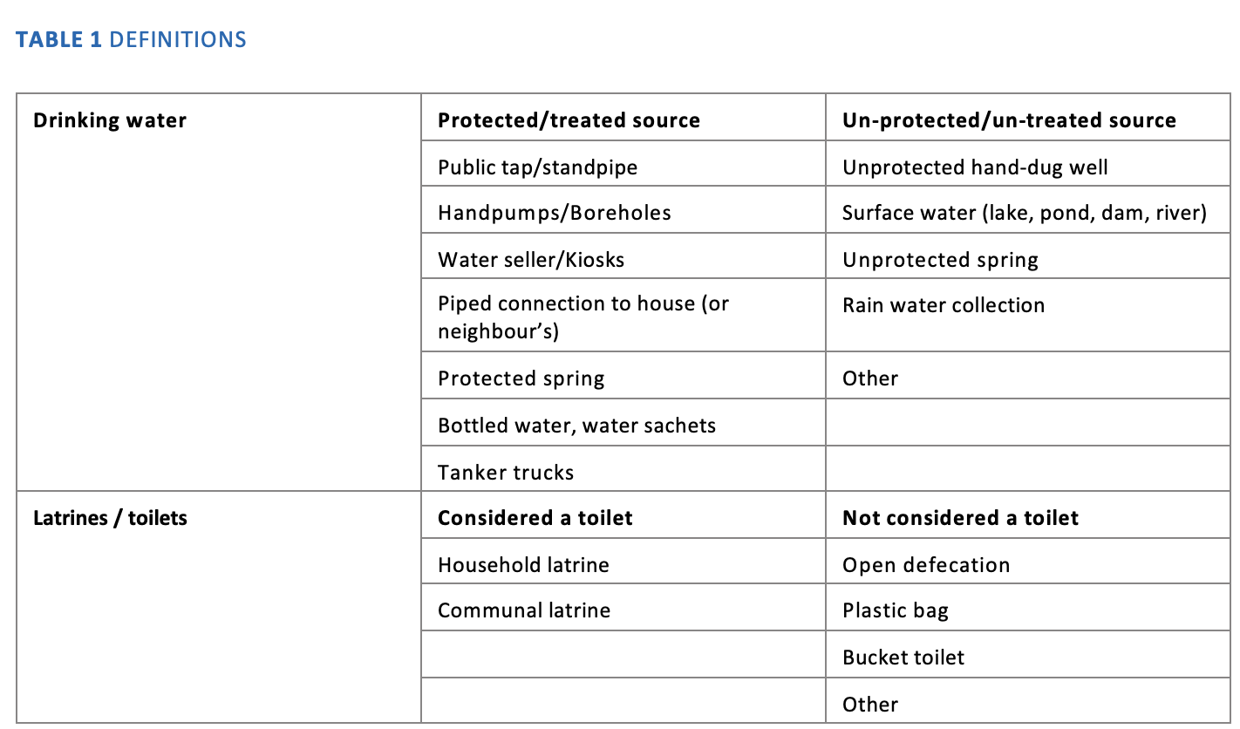
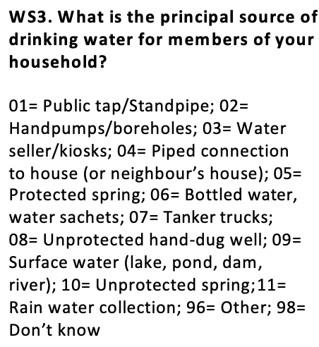
Data processing
Converted qualitative descriptions to a quantitative scale
Water, Sanitation & Hygiene (WASH), UNHCR
Standardized expanded Nutrition Survey (SENS) Guidelines
for refugee populations
Unknown entries treated as a “neutral value”

Slide 17
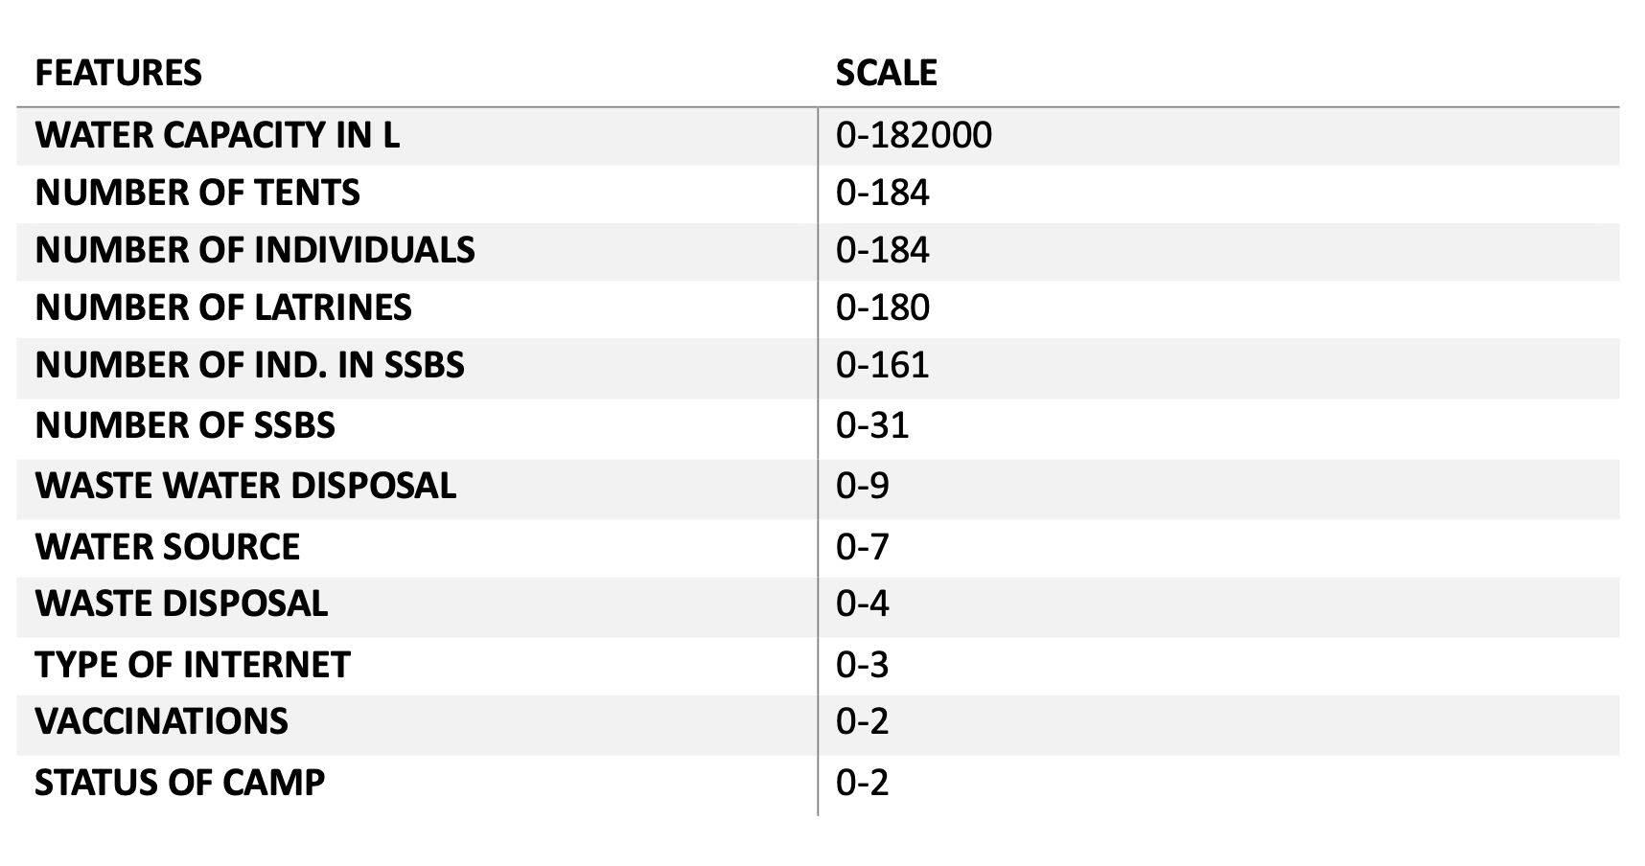
Scaled data
Scaled each data using MinMaxScaler from 0-1 to weight each feature equally.

Slide 18
MODEL

Slide 19
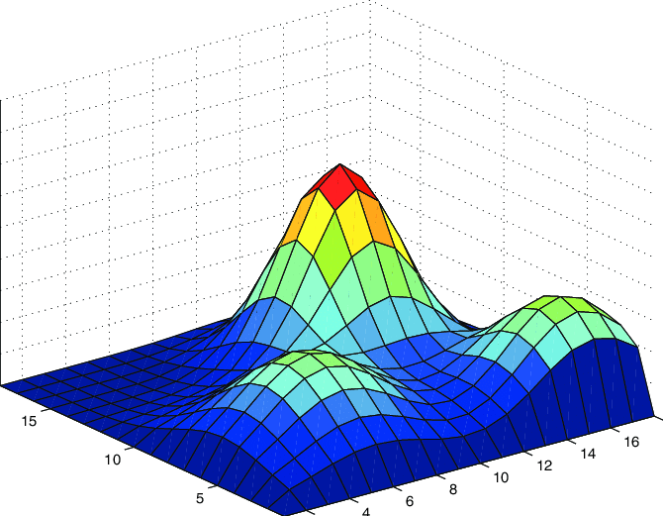
Gaussian Mixture Models
65 Gaussians & 64 Clusters
Assessed the similarity of top 10 clusters and Gaussians through Pearson Correlation Coefficient
Initializations for GMM at random(instead of “kmeans” or “k-means++” for independent groupings
12-features→ R^13 space

Slide 20
RESULTS & ANALYSIS

Slide 21
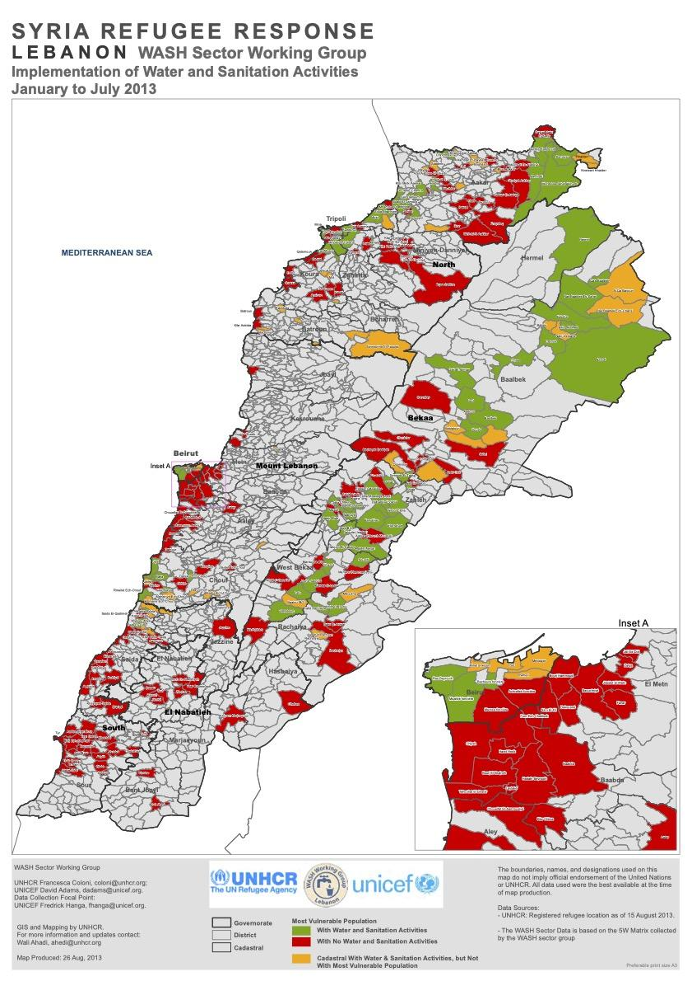
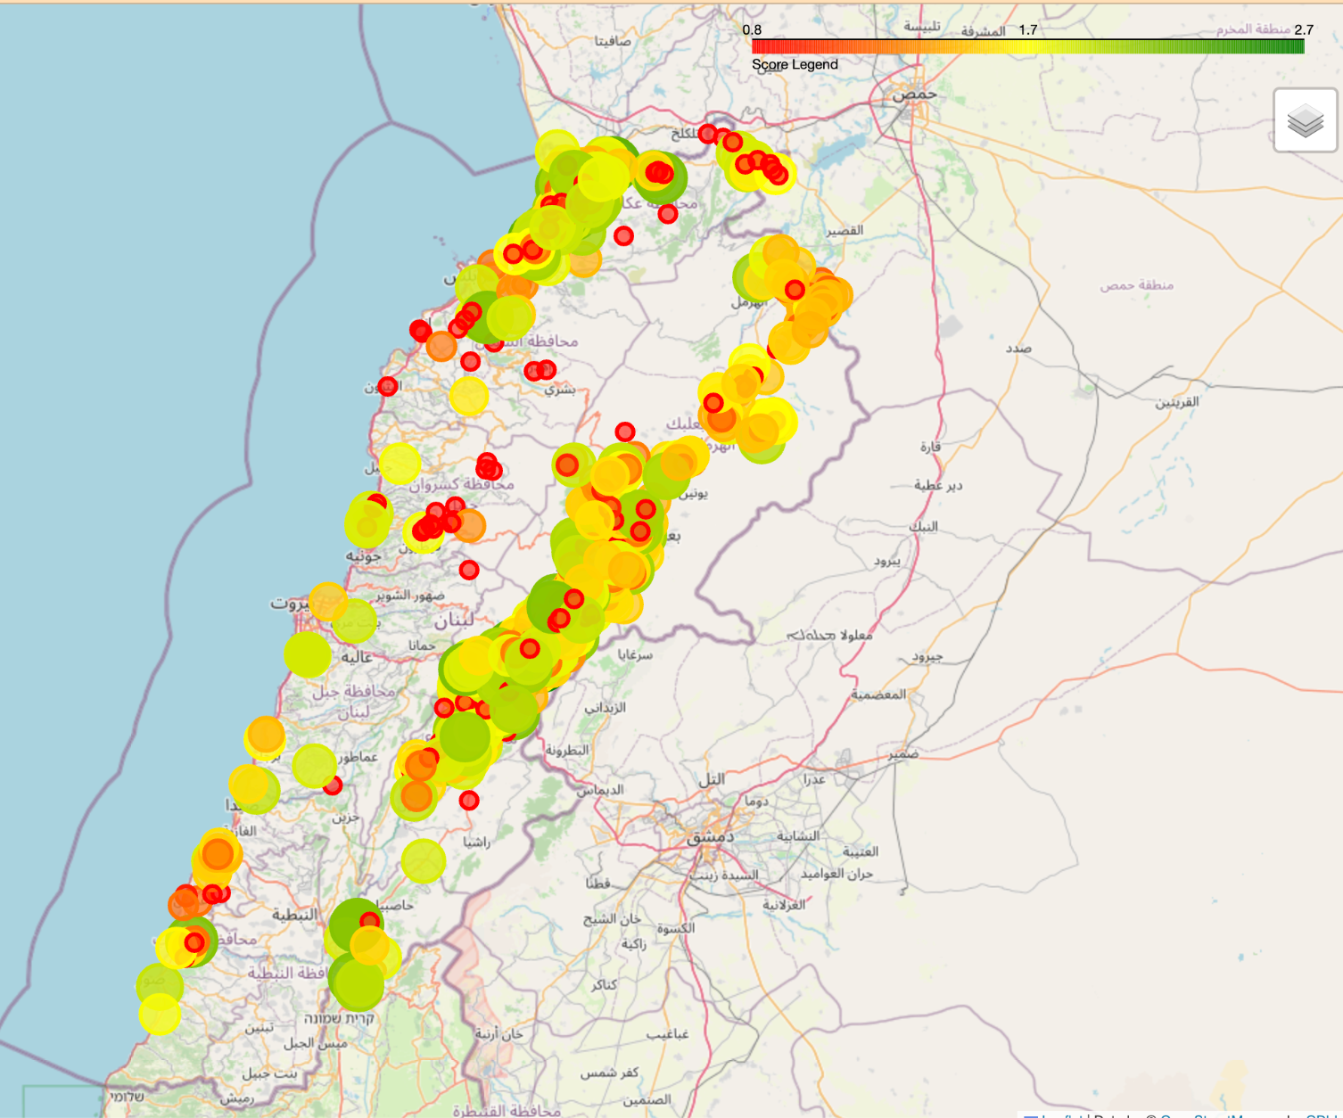
Broad Comparison
Comparing 2016 information data with July 2013 Graphic
WASH Survey Lebanon Registered refugee locations – 15 August 2013. collected from January to July 2013.

Slide 22
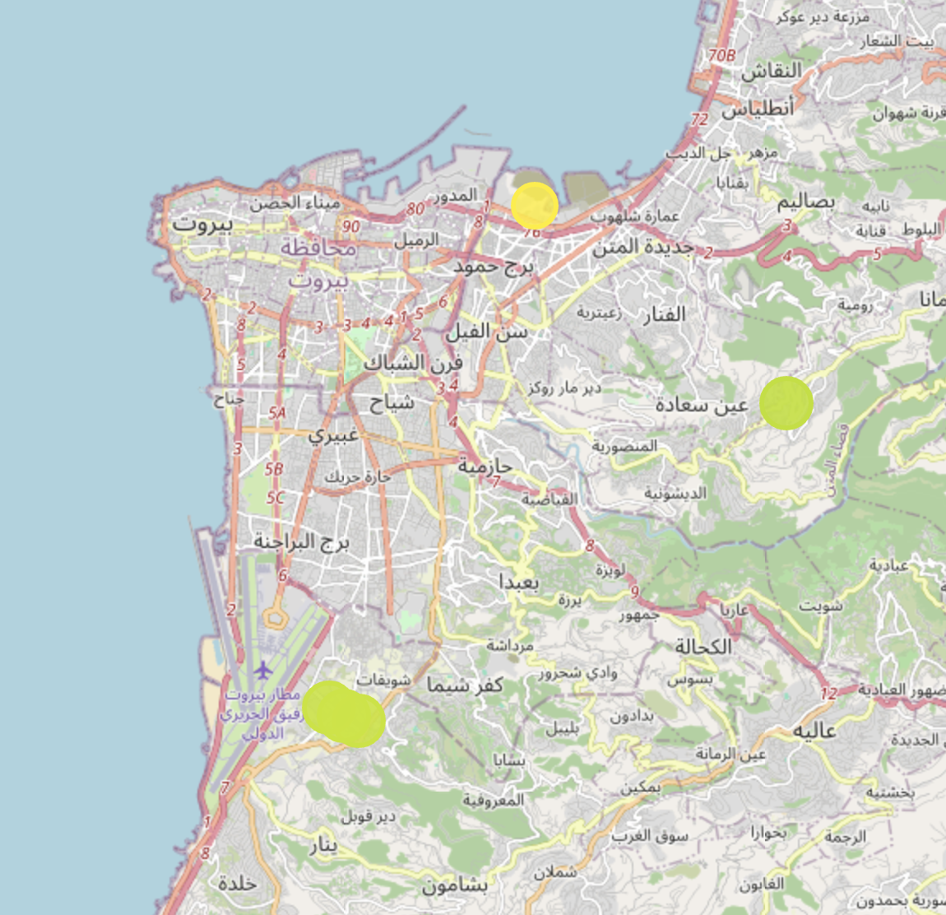
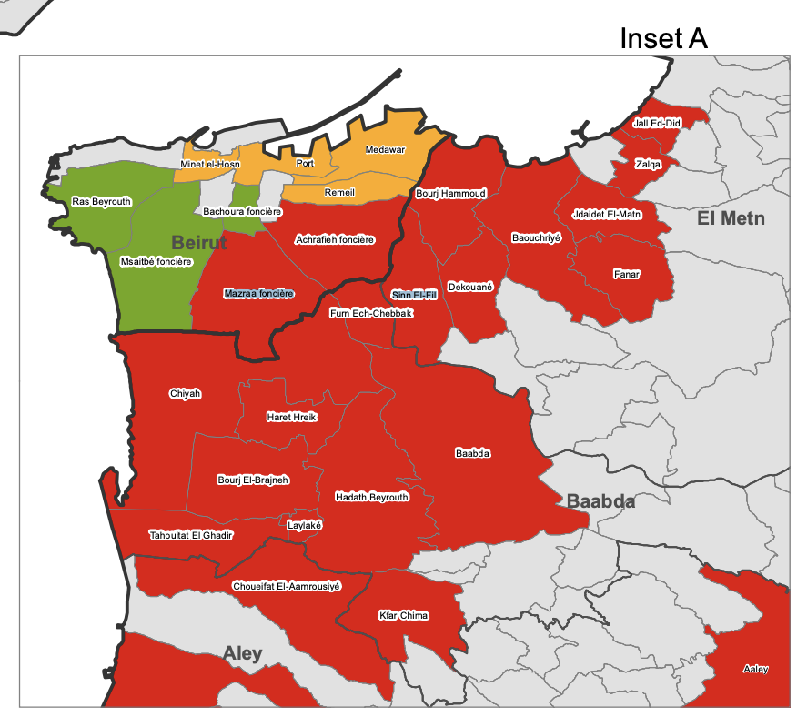
Beirut
Model is useful in rural regions because of lack of data, but less so in urban regions.

Slide 23
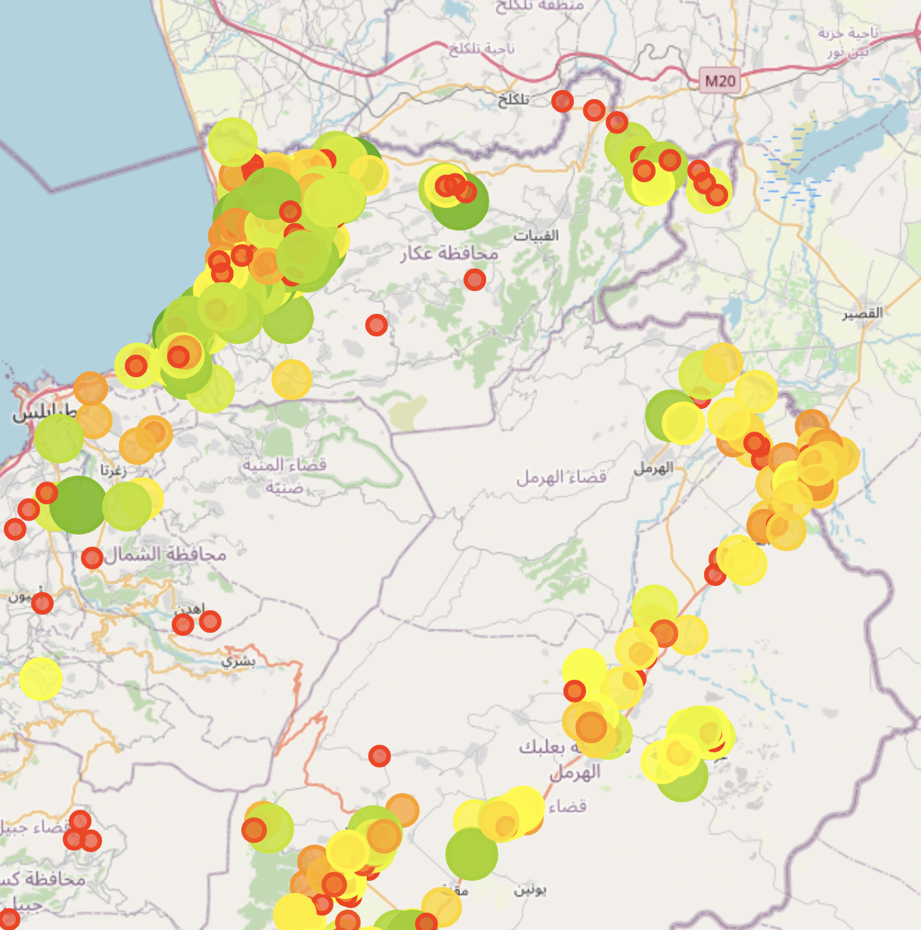
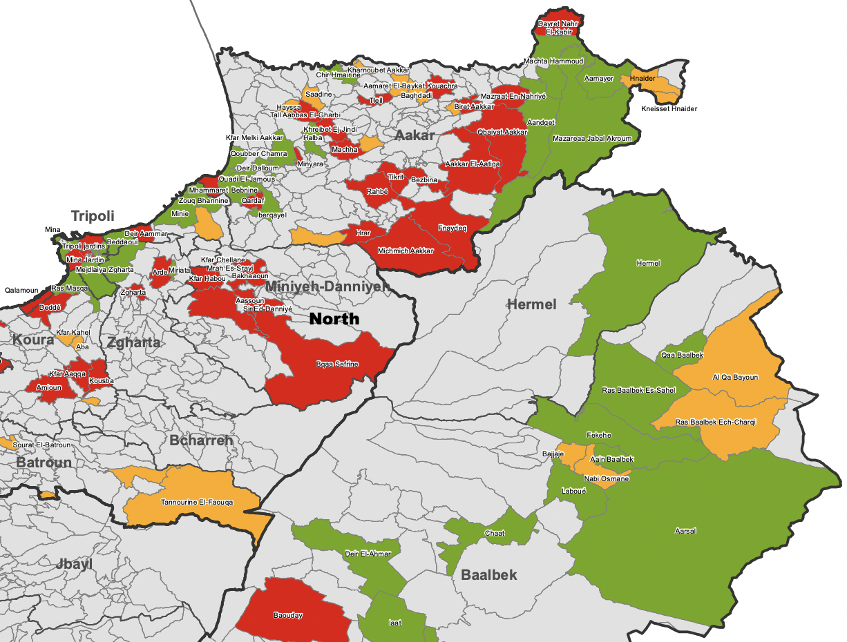
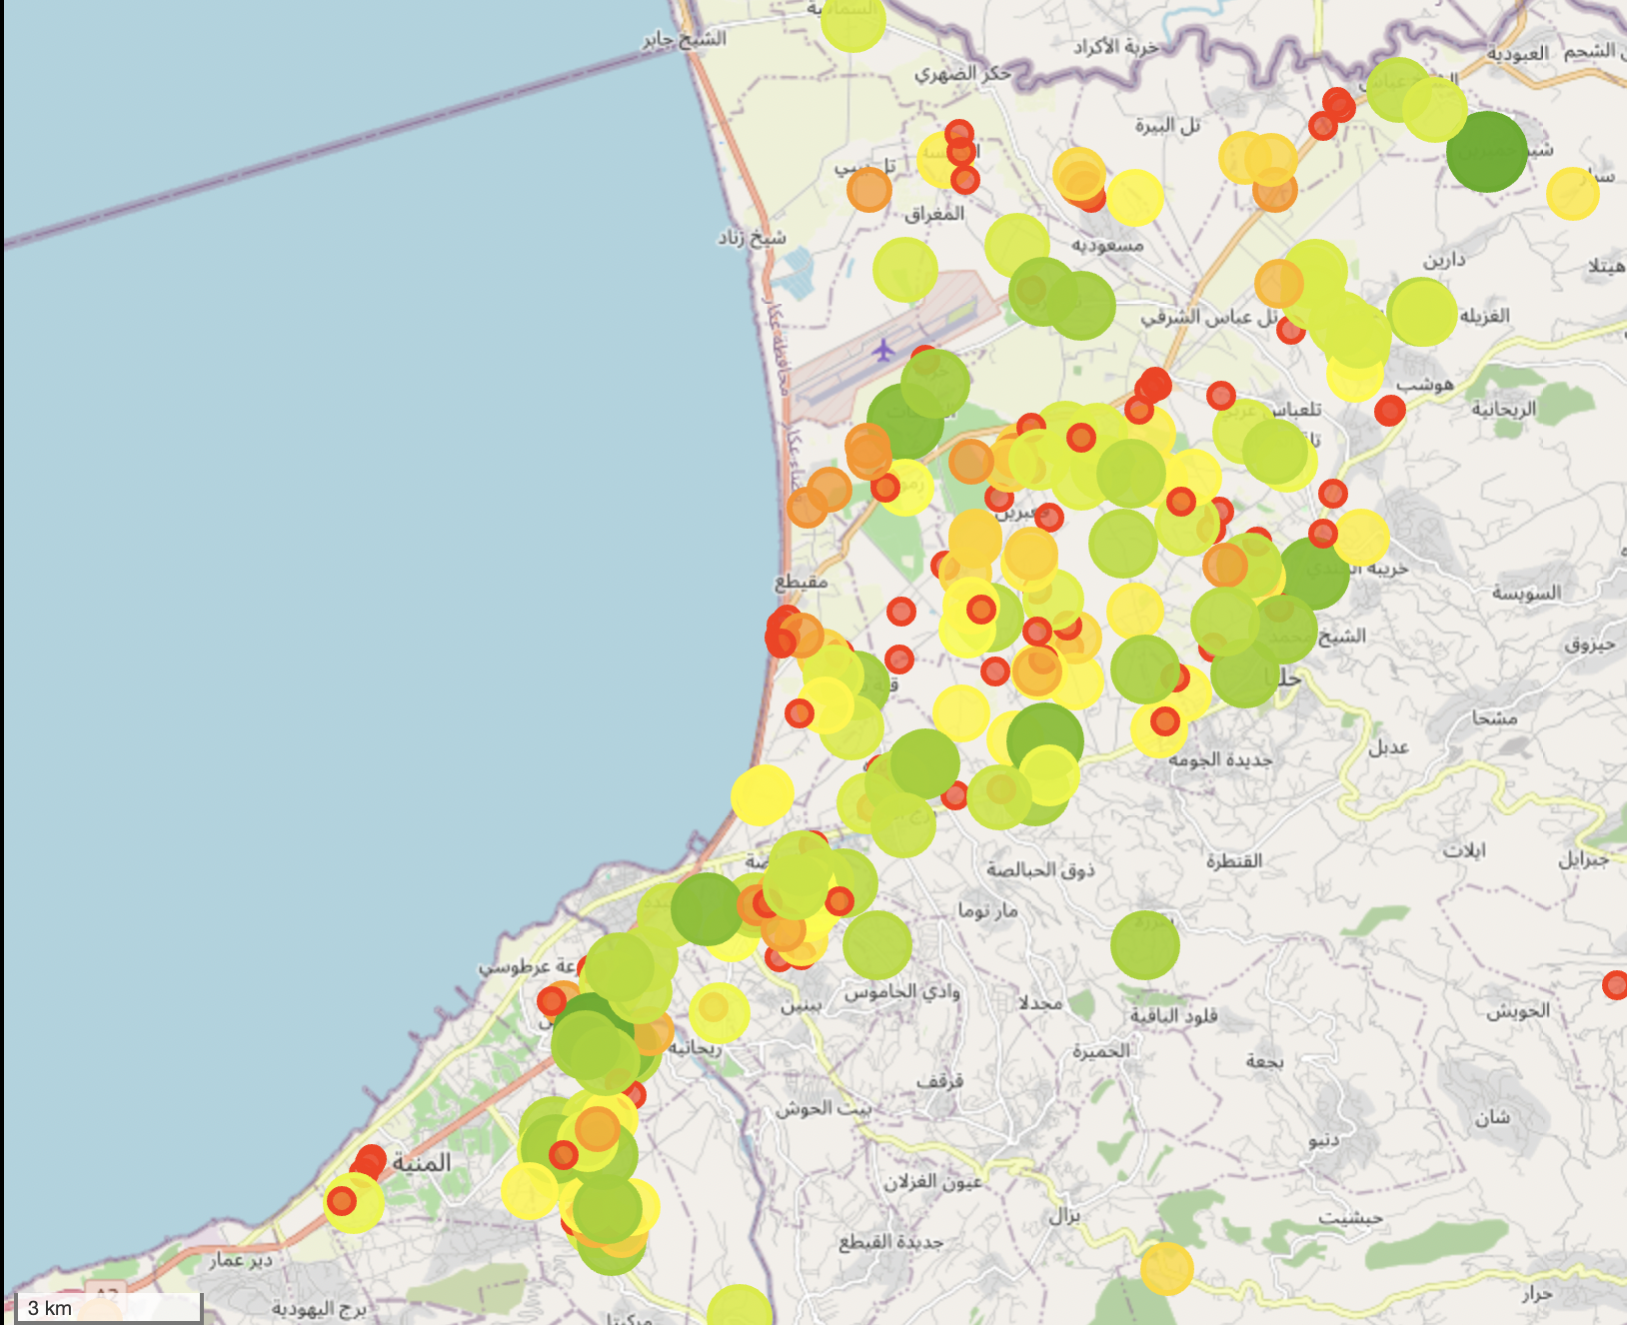
Northern Regions
Conclusions of WASH survey not entirely useful, provides broad overstatements and excludes some data.

Slide 24
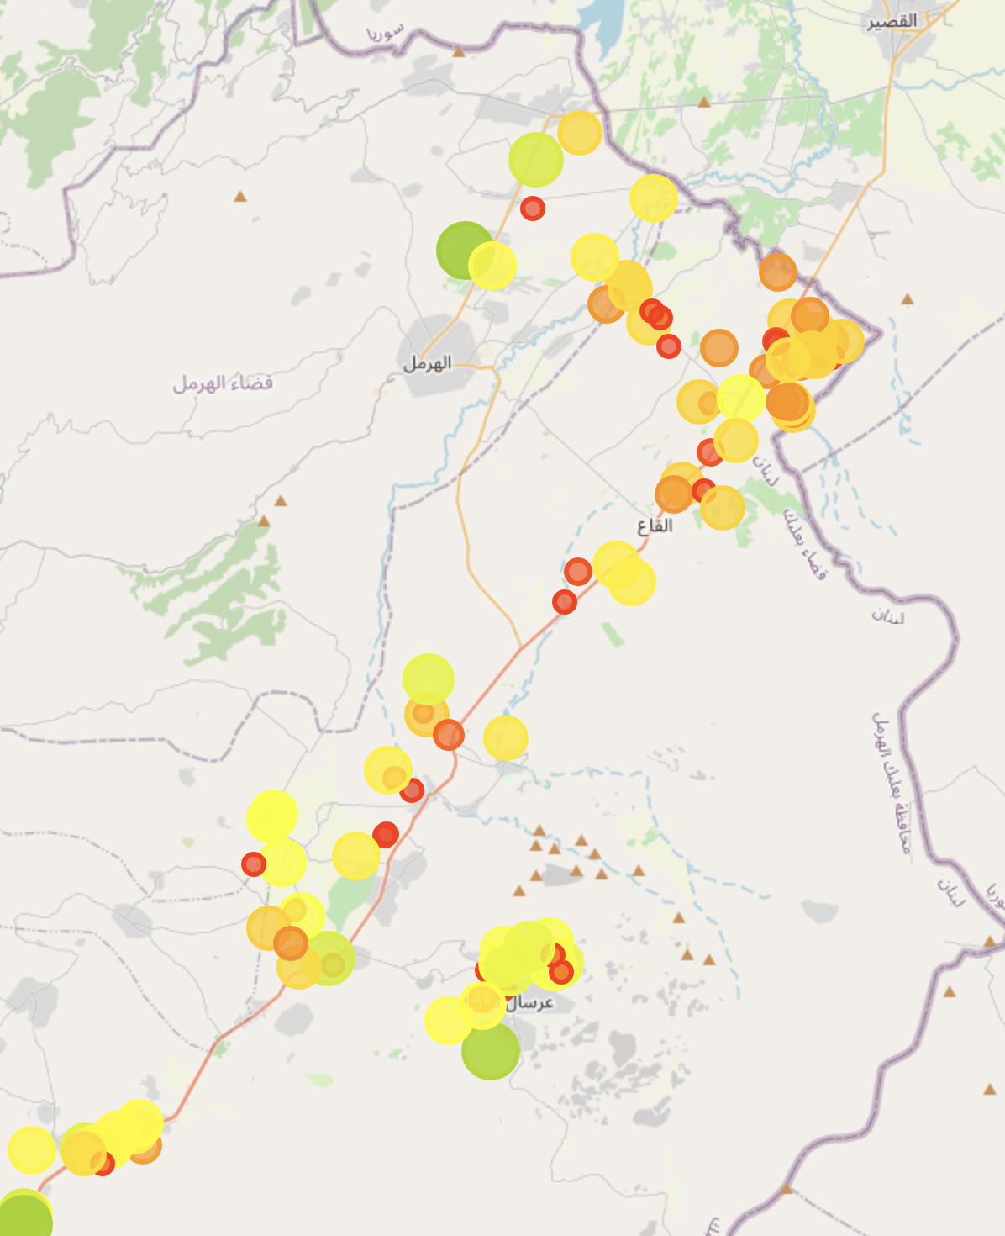
Northern Regions

Slide 25
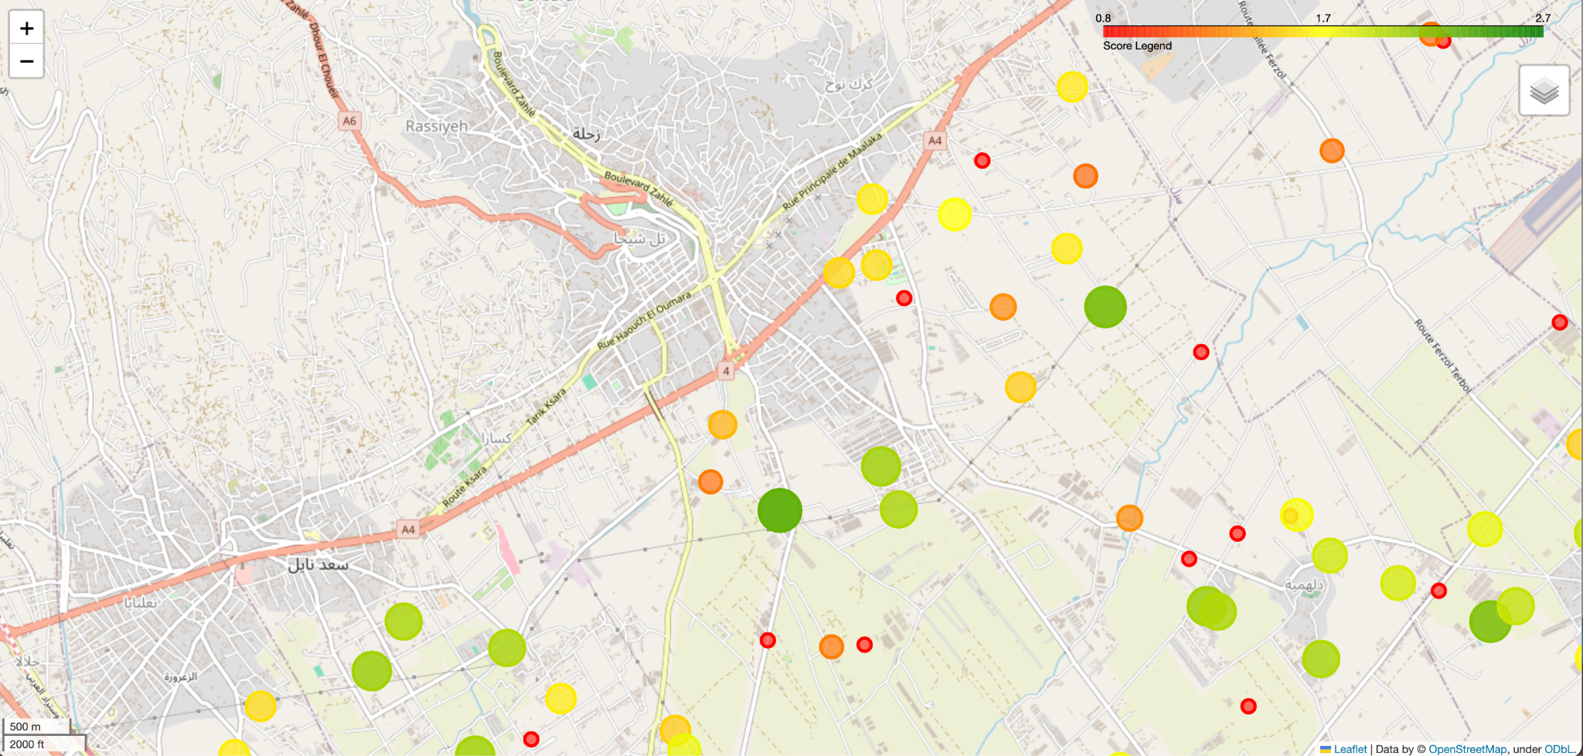
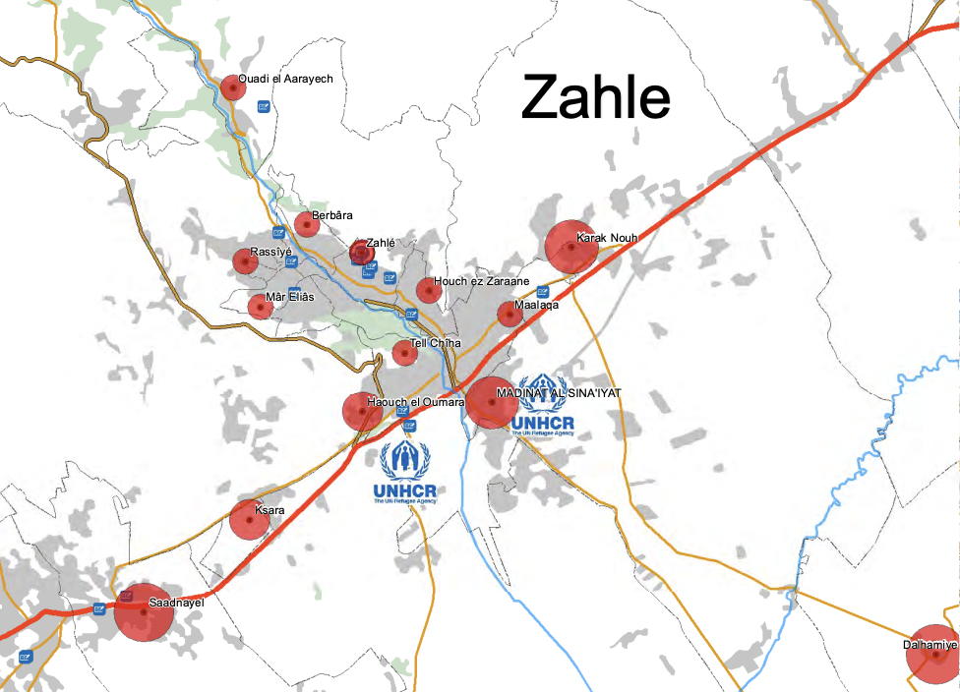
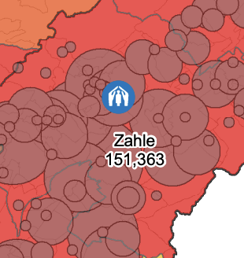
Zahle–combining education metrics
Fig X.
For informal settlements, choosing the best place to settle might mean less compromise overall on quality of life.

Slide 26
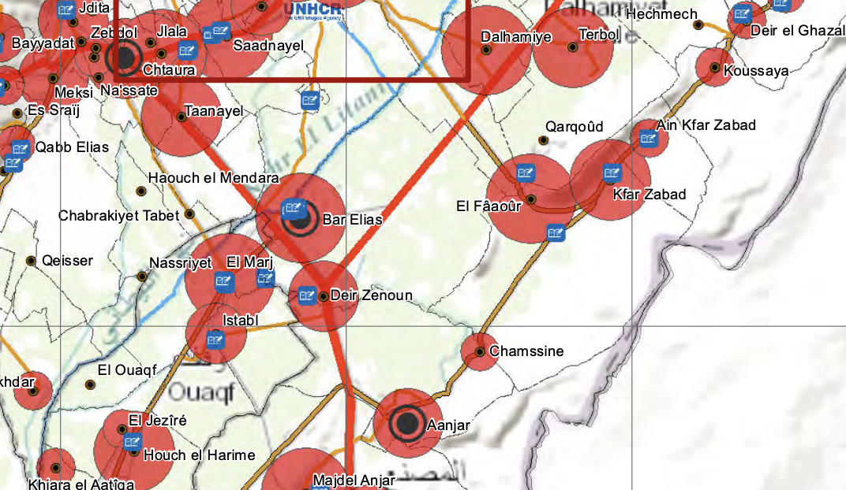
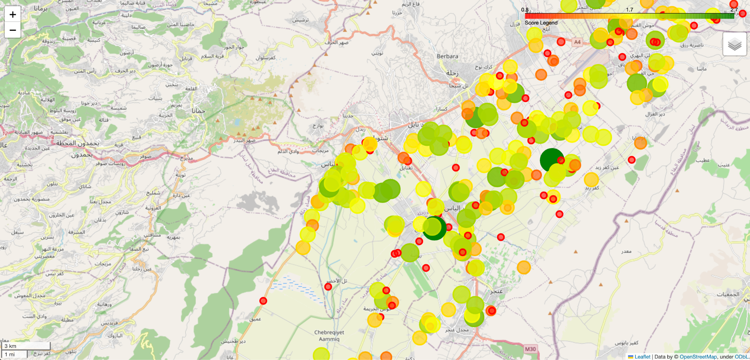
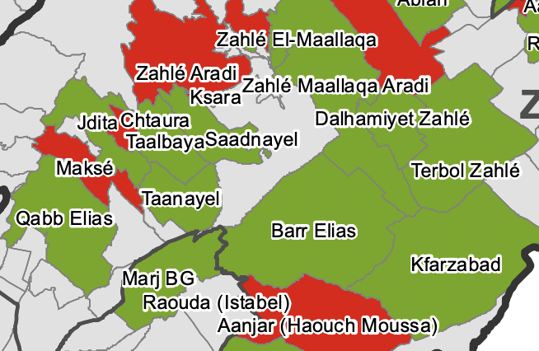
Best Regions–Dalhamiye to Elmarj
(region names highlighted under in blue)

Slide 27
Advantages of RRAM
Demand for displaced model can predict how many are displaced, with well-rated locations available for people who need new places to go. Allows countries and international organizations to predict and plan for how to deal with people displaced from large disasters.
Practical–no UNHCR data for informal settlements
Scalable & Generalizable–works for domestic and international displacement
Divisible–can stand alone and can be combined with other models easily
Identifiable–what features contribute to a high rating, what needs to be improved on

Slide 28
Disadvantages and Extensions of RRAM
Natural disasters are hard to predict where, so demand for displaced is less predictable, need more data, more features
Combine with vulnerabilities data to provide a more accurate recommendation
Chad, Bangladesh, Uganda, DRC(African and Asian countries) data available using similar metrics–easily disseminable to other sources

Slide 29
Thank you!

